Slide 1

Hosanna Church International
New Member
Orientation
PASTOR MATTHEW GUNN
LADY KIMBERLY GUNN
Where Jesus is lifted, Believers are liberated, and Everyone is loved.

Slide 2

WHAT TO EXPECT
Discussion Points
Ice Breaker
Welcome to the Family
Our History
Our Leaders
Apostolic Covering
Church Ministries & Leaders
What We Believe
Mission & Vison
Core Values
Church Membership
Spiritual Foundations
Spiritual Gift Assessments

Slide 3
Welcome to the Family!
A Hearty Welcome,
We thank God that you have taken interest in Hosanna Church International. We believe that it is within God’s plan that we should come to know you and be part of your life as you also become part of ours. We, at Hosanna Church, seek to be a home of all God’s people coming from all nationalities, tribes, cultures, and languages.
We invite you to take a closer look at us by participating in our services and ministries relevant to your needs. Our worship services are designed to accommodate contemporary songs, psalms, and hymns that allow freedom of Christ-centered worship. We have a voluntary staff of men and women who love God and seek to serve him and through serving others in the manner that will bring glory to God’s name and also advance the coming of his Kingdom.

Slide 4
It is our prayer that you will grow to know God and experience his closeness in our worship service, especially through inspiring relevant messages from the Word of God. If you have not already come to know and experience God in such a close way, we pray that you will come to know him here in Hosanna Church. By joining Hosanna, you have joined one big family of God’s people who enjoy life as a community that enjoys fellowship with God and with one another. We are a caring church that seeks to remain true to the firm foundations of the Christian church as outlined in Acts 2 where we take inspiration for our ministry.
Welcome to the family! Where Jesus is lifted, Believers are liberated, and Everyone is loved.
Yours in Christ,
Pastor Matthew Gunn, Pastor Hosanna Church Intl.(Pooler, Georgia)
Welcome to the Family!

Slide 5
History
HOW WE STARTED
Hosanna Church Incorporated was officially established on May 16, 2019 by our Founder & Pastor Matthew Gunn. Twenty years prior in August of 1999, Pastor Gunn received revelation of the name Hosanna and adapted as part of his spiritual journey. For several years throughout college and beyond he adapted this name as his email address, passwords, and etc.
Pastor Gunn was directed by God to begin interest meetings weekly at various locations throughout Savannah. Pastor Gunn also started a weekly bible study downtown at a Coffee Shop that provided an opportunity to engage with various people. As a result, Pastor Gunn began Hosanna Church with a launch team of eight people.

Slide 6
History
HOW WE STARTED
After weeks of planning, training, praying, and fasting, Hosanna Church began its first official service in the home of Pastor Matthew and Kimberly Gunn on Sunday, October 6, 2020. The church met at their home for 1 month, and held services at the West Chatham YMCA in Pooler, GA for 6 months until COVID 19 hit. Hosanna Church moved into a new location at Savannah Mall on March 10, 2020 where it remained for over a year until a flood damaged the space and eventually the mall closed.
June 2021, Hosanna moved into its current location and experienced tremendous success and creativity. Hosanna added 10 ministries, 5 people on staff, and continued to add to increase membership.

Slide 7
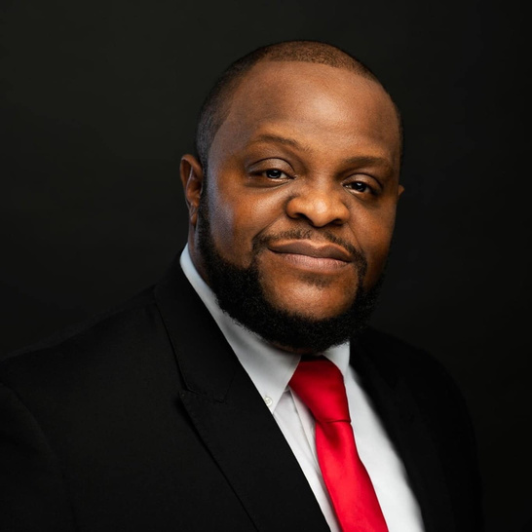
Our Leaders
Pastor Matthew Gunn was raised in Social Circle, GA. He received Christ at age 12, accepted call to preach at age 16. Pastor served in various roles in the church. He was licensed in ministry in 2002 and ordained in ministry in 2006. He founded Matthew Gunn Ministries in 2012, a mobile evangelism and outreach ministry serving those in need.
Pastor Matt and Lady Kim planted Hosanna Church on May 6, 2019 and it was later renamed to Hosanna Church International in 2023.
Graduate of Savannah State University & attended Luther Rice Seminary, he is currently employed with CareSource as Community Education Team Lead for Southern Georgia.
Hobbies: traveling, anything sports, and playing spades.
Favorite movie: Lean On Me
Pastor Matthew Gunn

Slide 8
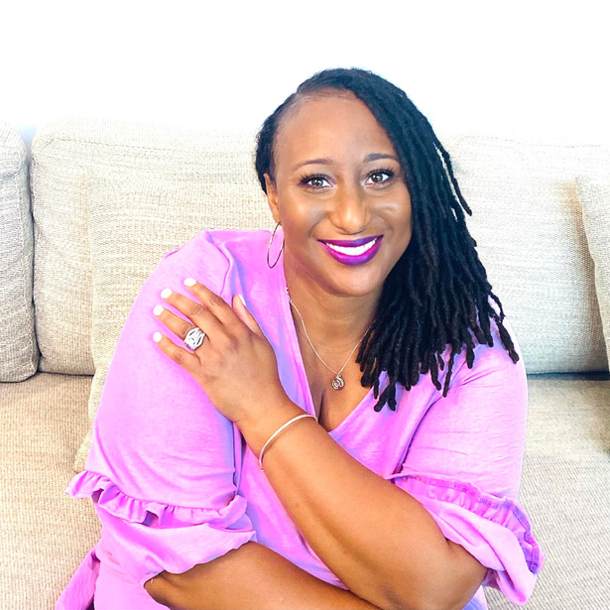
Our Leaders
Lady Kimberly Gunn
Lady Gunn was born and raised in Waynesboro, GA. She accepted Christ at eight. Her and her parents were founders of their childhood church. She grew up singing in church in various choirs and praise teams. She often lead songs and hymns. She participated in the school choirs, held various leadership roles for her class including Miss Black Burke County 2000. She recorded her first music project in 2010, “Hold On”.
Lady Gunn currently performs as a recording artist across the Southeast Region. She is the owner of Kimberly Gunn Enterprises and The Love & Soul Experience in 2012. Kimberly also founded the Love & Soul Family Festival.
She is a graduate of Augusta State University and Liberty University and is certified in health and life insurance as well as mental health advocacy.
Hobbies: outdoors, resting, and traveling
Favorite TV show: Golden Girls

Slide 9
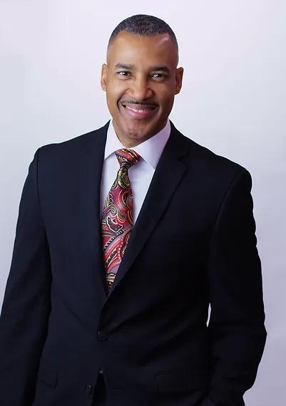
Apostolic Covering
Apostle Isaac Pitre
Pastor Matthew & Lady Gunn are under the Apostolic Covering of Apostle Isaac Pitre and part of the II Kings Global Network.
Isaac Pitre is the President of Isaac Pitre Ministries, Founder and Apostolic overseer of Christ Nations Church, and Leader of II Kings Global Network.
With over 30 years in full time ministry, Isaac travels throughout the nation and around the world ministering in various Conferences, Churches, and Christian Television Networks. In addition, Isaac has also produced several musical projects and authored two books, “THE DIVINE DNA” and his latest, “TAKE BACK YOUR AUTHORITY” released in 2023.
Isaac’s greatest passion is to see the body of Christ rise and walk in its true IDENTITY and AUTHORITY in the earth. Isaac’s ministry is based in Dallas, Texas where he resides with his beautiful wife Janet.

Slide 10
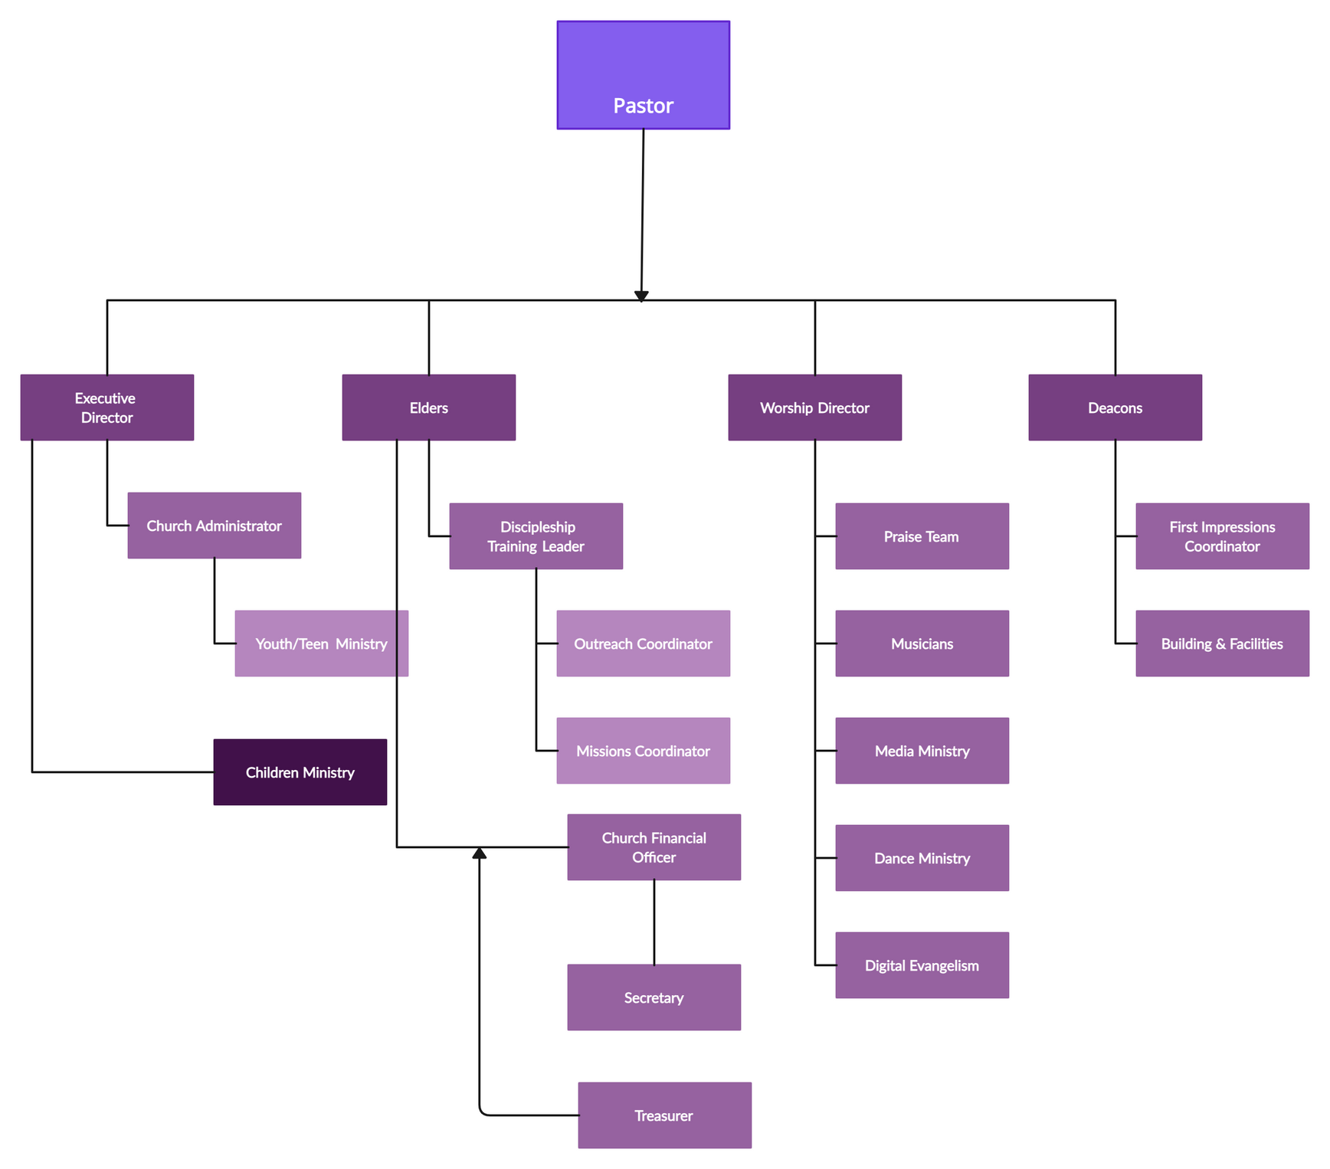
Hosanna Flow Chart

Slide 11
Church Ministries & Leaders
Hosanna Church Ministries 2024
Kingdom Kids Children’s Ministry-Essence Moore
Nu Fire-Teen Ministry-Lawanda Robinson
Refresher Women’s Ministry-Lady Gunn
Worship & Arts Ministry-Lady Gunn
Dance Ministry-Lawanda Robinson
Media Ministry-C’Nai Thompson
First Impressions Ministry-Harold Brown
Intercessory Prayer Ministry-Elder James Brannen
Fresh Start New Membership Ministry-Pastor Gunn
Transportation Ministry -Miguel Moore
Health & Wellness Ministry-Analicia Patterson
Special Events Ministry Team-Lady Kimberly Gunn
Outreach Ministry-Pastor Gunn
Hosanna Church Leadership Team
Pastor Matthew Gunn
Lady Kimberly Gunn
Lawanda Robinson
Harold Brown
Essence Moore

Slide 12

CHURCH MEMBERSHIP
ARTICLE IV MEMBERSHIP
This organization shall have members. A member is one who attends regularly, serves at and contributes financially to Hosanna Church.
Section 1. Candidacy Candidates for membership may approach a ministry leader or come forward during one of the worship service altar calls and share their desire to join Hosanna Church. Believers may join as new converts, through Christian experience, including licensed and ordained leaders, and by letter from another Christian Church.
Section 2. Membership Intake Each member shall participate in a new members orientation course and upon completion will receive a certificate of membership, which will become an official Church record. Each member is expected to become a faithful and regular tither of the Church, giving 10% of their income to the work of the ministry in accordance with the Holy Scriptures, in demonstration of covenant with the Church and God. Members shall maintain regular attendance and accountability to leadership. A member’s absence for a period of twelve consecutive months (without any communications with the Senior Pastor) indicates that the membership has come to an end, and they are no longer considered a member. If after the long-term absence, they return, they are welcomed into the fellowship as nonmembers. In order to reinstate membership, former members should meet with a member of the leadership team.
Section 3: Termination of Membership Members shall be removed from the Church roll for the following reasons: a. Death or personal request of the member. b. Absence from worship services for twelve consecutive months (without any communications with the Senior Pastor). c. Another reason as deemed unavoidable for the Senior Pastor.

Slide 13

What We Believe
THE BIBLE
The Bible is God’s Word to all people. It was written by human authors under the supernatural guidance of the Holy Spirit. Because it was inspired by God, the Bible is truth without any mixture of error and is completely relevant to our daily lives.
TRINITY
God has existed in relationship with Himself for all eternity. He exists as one substance in three persons: the Father, the Son and the Holy Spirit. Although each member of the Trinity serves different functions, they each possess equal power and authority.
THE FATHER
God is great: He is all powerful, all knowing, ever present, unchanging, completely worthy of our trust, and above all, Holy. It is in Him that we live, move and exist. God is good. He is our Father. He is loving, compassionate, and faithful to His people and His promises.
THE SONSON
Jesus Christ is completely human but, at the same time, completely God. He is the only plan for bringing people who are far from God back into a right relationship with God. He lived a perfect life, so that He could be a substitution for us in satisfying God’s demands for perfection. He defeated death in His resurrection so that we can have life.

Slide 14
What We Believe
THE HOLY SPIRIT
The Holy Spirit’s presence assures us of our relationship with Christ. He guides believers into all truth and exalts Christ. He convicts people of their sin, God’s righteousness, and the coming judgment. He comforts us, gives us spiritual gifts, and makes us more like Christ.
ETERNITY
Man was created to exist forever. He will exist either eternally separated from God by sin or in union with God through forgiveness and salvation. To be eternally separated from God is Hell. To be eternally in union with Him is Heaven. Heaven and Hell are places of eternal existence.
MAN
Man is made in the image of God and is the supreme object of His creation. Man was created to have fellowship with God but became separated in that relationship through sinful disobedience. As a result, man cannot attain a right relationship with God through his own effort. Every human personality is uniquely created, possesses dignity, and is worthy of respect and Christian love.
SALVATION
The blood of Jesus Christ, shed on the cross, provides the only way of salvation through the forgiveness of sin. Salvation occurs when people place their faith in the death and resurrection of Christ as sufficient payment for their sin. Salvation is a gift from God, and it cannot be earned through our own efforts.
THE CHURCH
The Church is a local community of baptized believers unified through faith in Christ. It is committed to the teachings of Christ and obeying all of His commands, and it seeks to bring the Gospel to the world. The Church works together in love and unity, intent on the ultimate purpose of glorifying Christ.

Slide 15
MISSION & VISION
OUR VISION
To become a church where the unchurched would love to attend and can experience God personally. Where Jesus is lifted, Believers are liberated, and Everyone is loved.
MISSION
We exist to lead people into a growing relationship with Jesus, making disciples, and preparing them to fulfill their purpose and calling in life.
Matthew 28:18–20; John 17:20–23; Acts 1:8

Slide 16

CORE VALUES
RELATIONSHIPS
BUILDING RELATIONSHIPS THROUGH SERVICE TO OTHERS.
CULTURE
ESTABLISHING A CULTURE OF FELLOWSHIP, LOVE, AND SUPPORT.
DISCIPLESHIP
MAKING DISCIPLES AND EQUIPPING LEADERS FOR THE KINGDOM OF GOD.
TRANSFORMATION
SOCIAL TRANSFORMATION THROUGH LIVING OUT THE MESSAGE AND MISSION OF JESUS CHRIST.

Slide 17

Questions & Answers
Where Jesus is lifted, Believers are liberated, and Everyone is loved.

Slide 18
Spiritual Gift Assessment
AS A FOLLOWER OF JESUS, EXPLORING AND EXERCISING YOUR SPIRITUAL GIFTING IS A VITAL AND EXCITING PART OF YOUR SPIRITUAL JOURNEY. THIS SITE IS DESIGNED AS A TOOL TO HELP YOU DISCERN THE SPIRITUAL GIFTS GOD HAS GIVEN YOU.
“THERE ARE DIFFERENT KINDS OF GIFTS, BUT THE SAME SPIRIT DISTRIBUTES THEM. THERE ARE DIFFERENT KINDS OF SERVICE, BUT THE SAME LORD.” - 1 COR 12:4 NIV
https://giftstest.com/test
TAKE THE TEST
THE GIFTS TEST IS DESIGNED TO BE TAKEN QUICKLY DURING A SINGLE SITTING, AND TYPICALLY TAKES 5 MINUTES TO COMPLETE. WE ENCOURAGE YOU TO BE OPEN AND HONEST. ENJOY!

